Slide 1

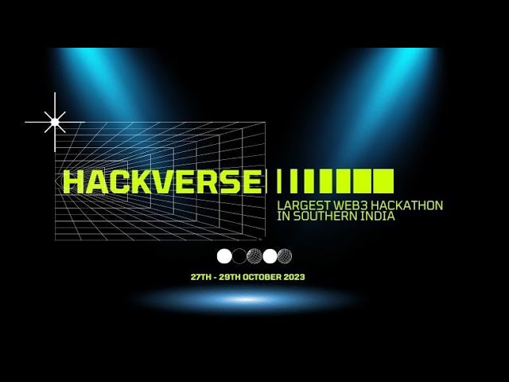
THEME-WEB3
PROJECT NAME :BlockLogistics - Blockchain-Based Supply Chain Management
DONE BY
S.KRITHIK GOKUL

Slide 2
CONTENTS
ABSTRACT
PROBLEM STATEMENT
ALGORITHMS USED
EXISTING SYSTEM
PROPOSED SYSTEM
SOFTWARE REQUIREMENTS
IMPLEMENTATION USING FULL STACK
BLOCK DIAGRAM
ADVANTAGES
APPLICATIONS
FUTURE SCOPE

Slide 3
ABSTRACT
This project introduces a blockchain-based supply chain management system to enhance security, transparency, and efficiency in the logistics industry. The proposed system, named "BlockLogistics," aims to address the challenges faced by the existing supply chain management solutions. This web application leverages blockchain technology to create an immutable ledger for tracking and managing the movement of goods from the source to the end consumer. It offers numerous advantages in terms of trust, security, and real-time tracking but does require overcoming certain complexities and resource demands.

Slide 4
PROBLEM STATEMENT
Blockchain technology has gained immense popularity for its secure and immutable ledger capabilities. However, implementing blockchain-based solutions can be complex and resource-intensive. The problem is to develop a web application that leverages blockchain technology to provide a secure and transparent system for supply chain management.

Slide 5
ALGORITHM USED TECHNIQUES
Web 3.0 Frameworks:
Frameworks like Web3.js and ethers.js facilitate the development of web applications that interact with blockchain networks.

Slide 6
EXISTING SYSTEM
The current supply chain management systems typically rely on centralized databases and traditional record-keeping methods. These systems often face issues such as data inconsistencies, fraud, lack of transparency, and limited traceability. Trust among supply chain participants is challenging to establish, and disputes are common due to the lack of a single source of truth. Existing systems often involve manual data entry, which can lead to errors and inefficiencies.

Slide 7
PROPOSED SYSTEM
BlockLogistics is a web application that utilizes blockchain technology to revolutionize supply chain management. The system allows participants, such as manufacturers, distributors, and retailers, to record and verify every transaction and movement of products on an immutable blockchain ledger. This ledger is decentralized and secure, providing a tamper-proof record of the supply chain. Key features include real-time visibility, smart contract automation, and a user-friendly interface for stakeholders to access information securely. The proposed system also enables transparency by allowing consumers to trace the origin and journey of the products they purchase.

Slide 8
SOFTWARE REQUIREMENTS
ONLINE COMPILER{C AND PYTHON}
JUPYTER NOTEBOOK

Slide 9
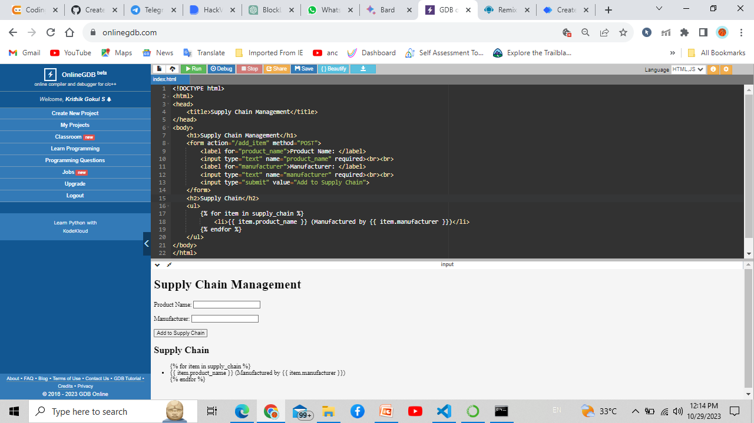
IMPLEMENTATION USING WEB HTML

Slide 10
IMPLEMENTATION USING PYTHON
import pip
import requests
# Install the necessary Python libraries
pip.install('requests')
# Make a request to the blockchain network
response = requests.get('https://example.com/api/supply_chain/get_product_provenance?product_id=12345')
# Parse the response data
data = response.json()
# Print the product provenance
print(data['product_provenance'])

Slide 11
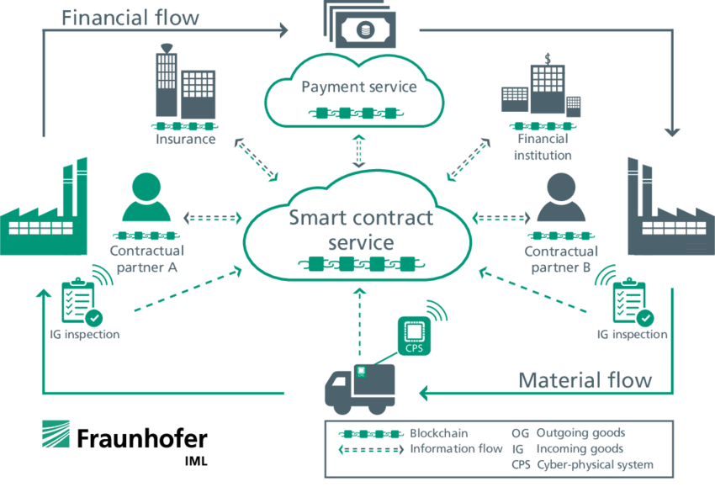
BLOCK DIAGRAM

Slide 12
ADVANTAGES
Security: BlockLogistics provides a secure and immutable ledger, reducing the risk of data tampering or fraud.
Transparency: Real-time tracking and traceability enhance transparency for all participants in the supply chain.
Efficiency: Smart contracts automate processes, reducing the need for intermediaries and streamlining operations.
Trust: Participants can trust the integrity of the data on the blockchain, reducing disputes and improving collaboration.
Consumer Confidence: End consumers can trace the origin of products, which can lead to increased trust and brand loyalty.

Slide 13
DISADVANTAGES
Complexity: Implementing a blockchain-based system can be complex and require a learning curve for participants.
Resource-Intensive: Setting up and maintaining a blockchain network demands significant computational and energy resources.
Cost: Initial implementation costs and ongoing maintenance can be high.
Scalability: Scalability challenges may arise as more participants and transactions are added to the blockchain network.

Slide 14
FUTURE SCOPE
The future of BlockLogistics includes addressing scalability concerns, further reducing resource demands, and enhancing user-friendliness. The adoption of interoperable blockchain standards and increased regulatory clarity will likely facilitate wider implementation. Moreover, the integration of IOT (Internet of Things) devices for real-time data input and enhanced analytics will be a crucial focus. As blockchain technology continues to mature, the potential for optimizing supply chain management remains promising, offering opportunities for increased efficiency and transparency in the global logistics industry.

Slide 15
